Slide 1
Predictive Maintenance of Industrial Machinery
CAPSTONE PROJECT
Presented By:
1. LOGESH S – SSMIET – B.E CSE (CYBER SECURITY)

Slide 2
OUTLINE
Problem Statement (Should not include solution)
Proposed System/Solution
System Development Approach (Technology Used)
Algorithm & Deployment
Result (Output Image)
Conclusion
Future Scope
References

Slide 3
Problem Statement
Develop a predictive maintenance model for a fleet of industrial machines to anticipate failures before they occur. This project will involve analyzing sensor data from machinery to identify patterns that precede a failure. The goal is to create a classification model that can predict the type of failure (e.g., tool wear, heat dissipation, power failure) based on real-time operational data. This will enable proactive maintenance, reducing downtime and operational costs.

Slide 4
Proposed Solution
Our solution uses machine learning to predict machinery failures in advance, helping reduce downtime and maintenance costs.
Data Collection: Use historical sensor data (temperature, torque, speed, tool wear, etc.) from machines.
Preprocessing: Clean and prepare the data by handling missing values and encoding machine types.
Modeling: Train a classification model (e.g., Random Forest or XGBoost) to detect failure types like tool wear or power failure.
Deployment: Deploy the model on IBM Cloud using Watson Studio and Watson Machine Learning.
Result: Real-time failure predictions that enable proactive maintenance and improve operational efficiency.

Slide 5
System Approach
This approach uses IBM Watson Studio’s AutoAI tool to automate model selection, training, and pipeline generation for predicting machinery failures.
System requirements
Platform: IBM Cloud (Lite Plan)
Tools Used:
IBM Watson Studio – For AutoAI experimentation
IBM Watson Machine Learning – For deployment of the pipeline
Library required to build the model
AutoAI Pipeline
Predictive maintenance Dataset

Slide 6
Algorithm & Deployment
Algorithm Selection:
We used IBM Watson AutoAI, which automatically compares multiple machine learning algorithms (e.g., Random Forest, Gradient Boosting, Logistic Regression) to find the best model for predicting machine failures based on sensor data. AutoAI also performs data cleaning, feature engineering, and hyperparameter optimization.
Data Input:
Features like air temperature, process temperature, rotational speed, torque, tool wear, and machine type.
Training Process:
AutoAI handles data preprocessing, splits data, and tunes model parameters to generate the best pipeline..
Prediction Process:
The best model pipeline is deployed as an API using IBM Watson Machine Learning, allowing real-time failure predictions from sensor inputs.

Slide 7
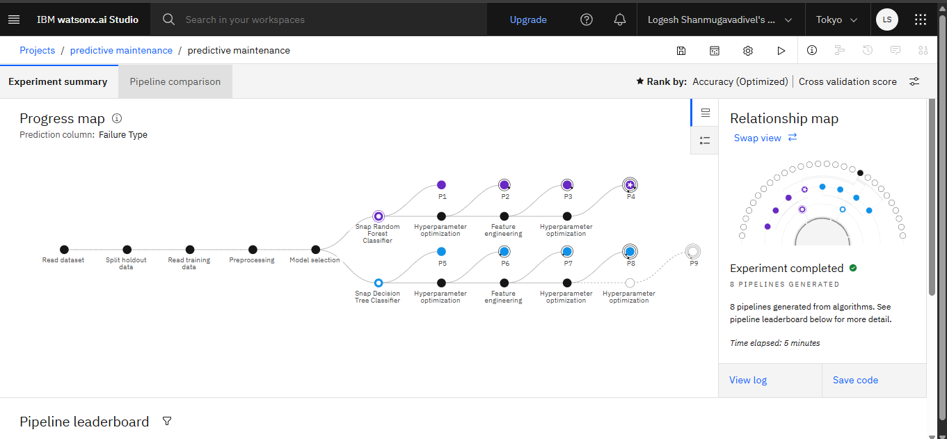
Result (Pipeline)

Slide 8
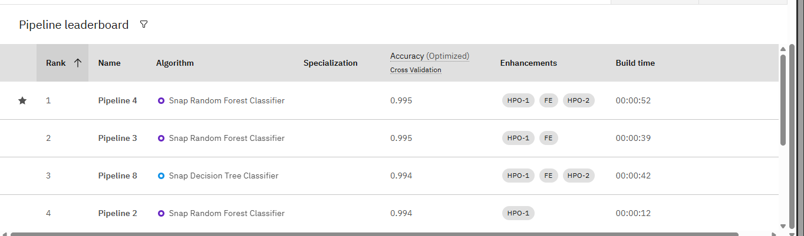
Result (pipeline leaderboard)

Slide 9
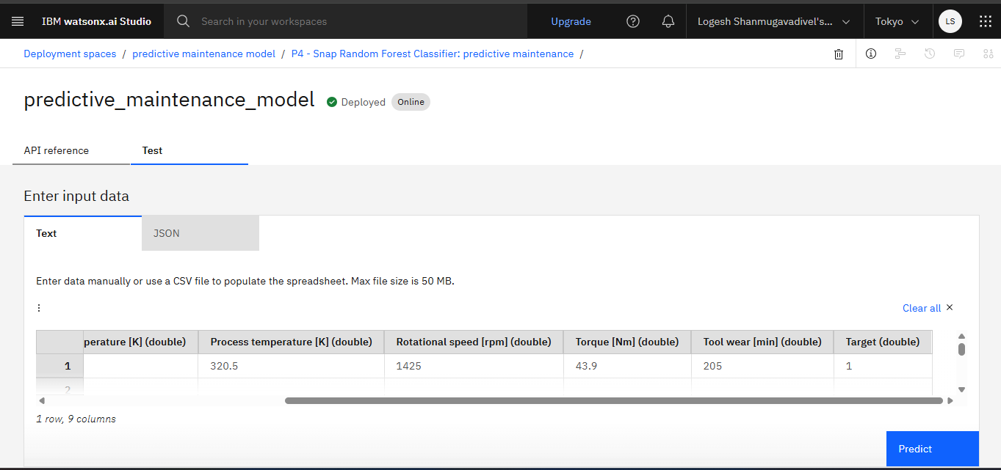
Result (Model Prediction)

Slide 10
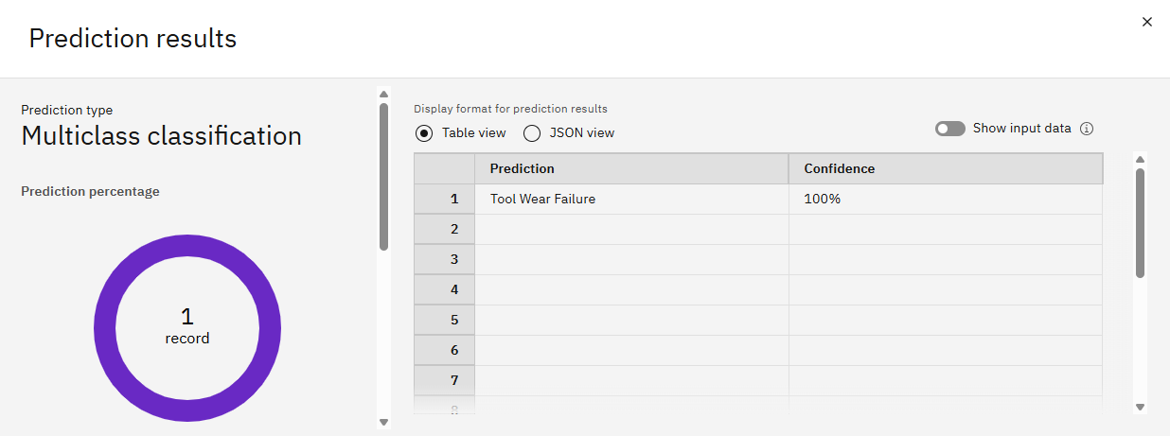
Result (PREDICTION)

Slide 11
Conclusion
The proposed solution using IBM AutoAI successfully predicts different types of machinery failures based on sensor data, enabling proactive maintenance.
The system helps reduce unexpected downtime, improve machine efficiency, and lower operational costs.
AutoAI simplified the model development process by automating preprocessing, algorithm selection, and tuning.

Slide 12
Future scope
Add real-time sensor and maintenance data
Improve model accuracy with advanced algorithms
Expand system to more machines and locations
Use edge devices for on-site predictions
Make predictions easier to understand with explainable AI

Slide 13
References
IBM DOCS
IBM ZOOM VIDEOS

Slide 14
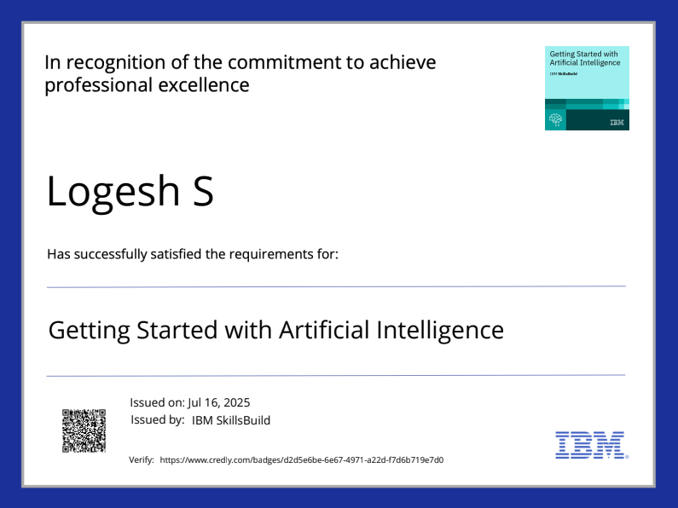
IBM Certifications

Slide 15
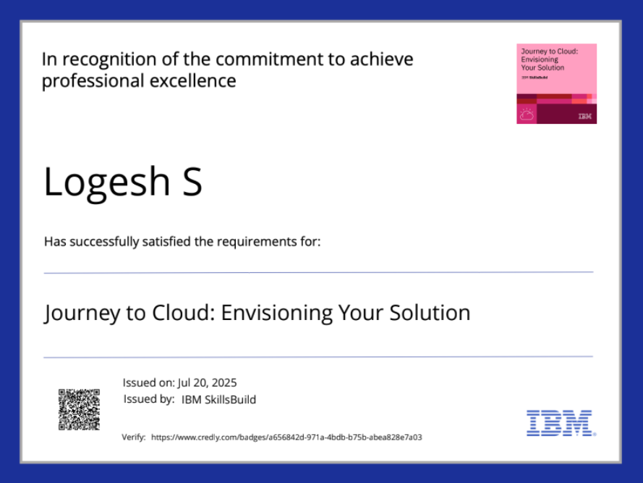
IBM Certifications

Slide 16
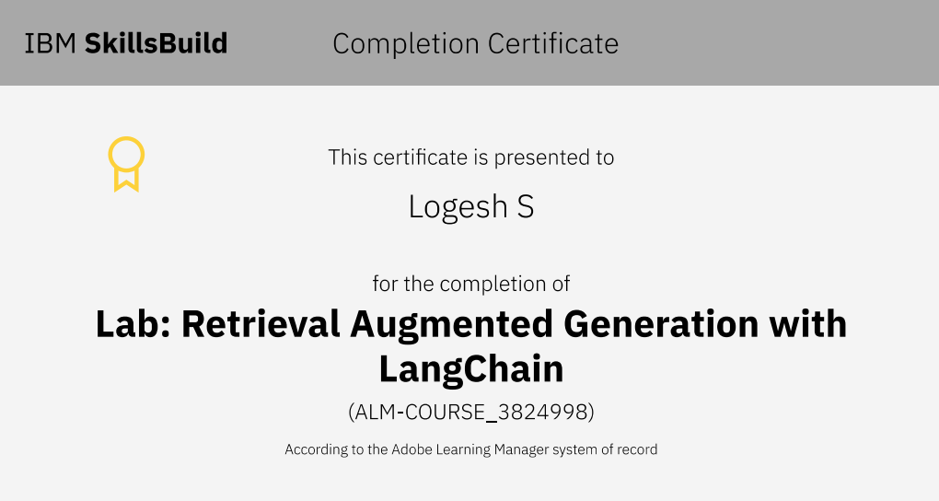
IBM Certifications

Slide 17
THANK YOU

